Slide 1

Aarnav
Jun
Computer Science
Software Engineering
Luis
Kyle
Medicine
Data Science

Slide 2
CALENDULA
Maximizing the Potential of Federated Multiagentic AI for Medical Referral

Slide 3
Imagine your child has just been diagnosed with brain cancer

Slide 4
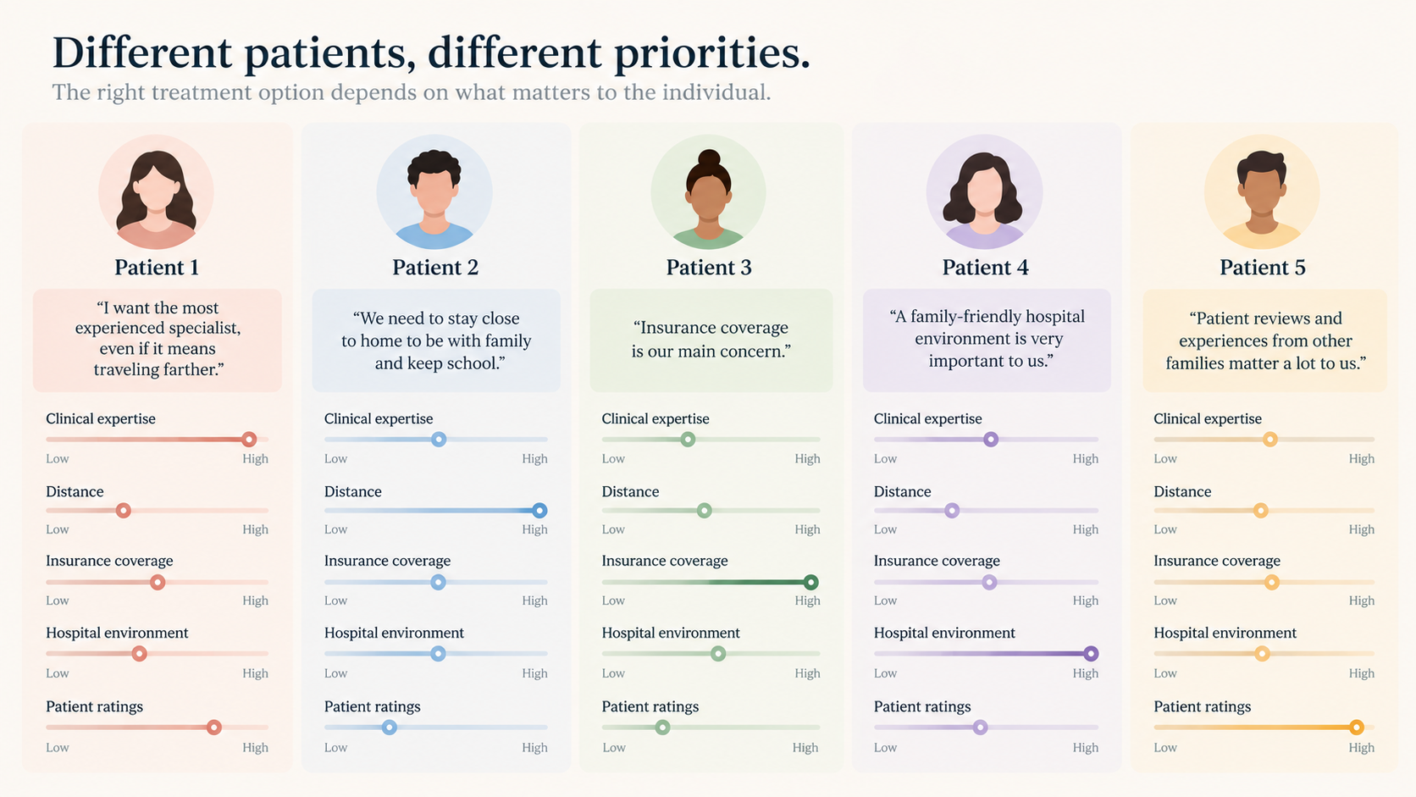

Treatment options matter to the individual

Slide 9
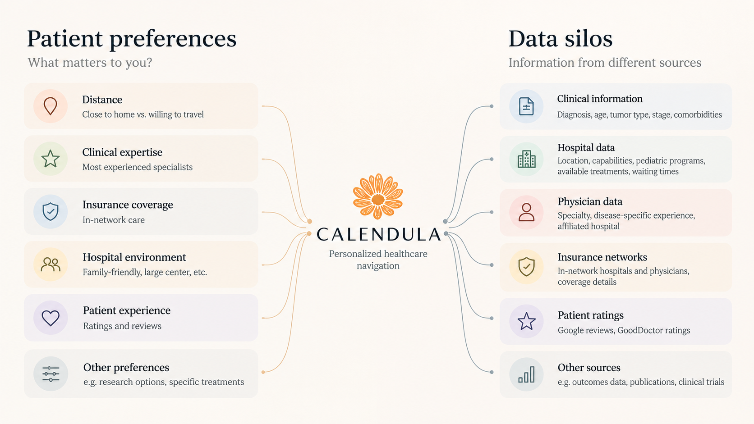
Patient Preferences
Data Silos
Personalized Referral

